Slide 1
W13 The basics of deep learning for archaeological site detection on remote sensor data.
By Iris Kramer and Jonathon Hare
Email: i.kramer@soton.ac.uk
Twitter: @ickkramer
iriskramer.com

Slide 2
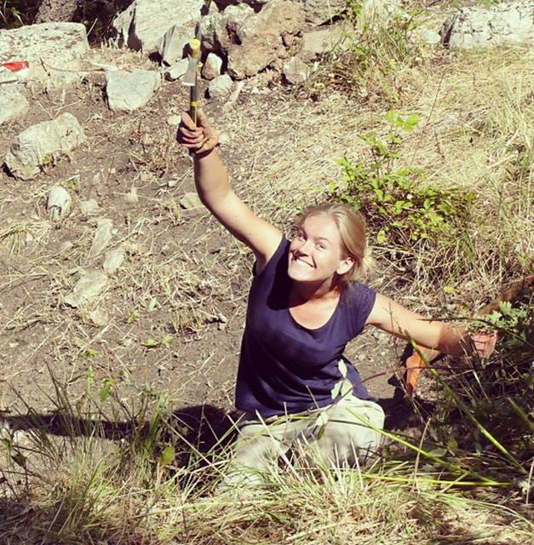
Who am I?
Studies
MSc Archaeological Computing 2014-2015 - supervised by Dr D. Wheatley at University of Southampton: “An archaeological reaction to the remote sensing data explosion. Reviewing the research on semi-automated pattern recognition and assessing the potential to integrate artificial intelligence”.
PhD Computer Science 2017-2020 - supervised by Dr J. Hare at University of Southampton: "New Approaches to Archaeology using Deep Learning with Remote Sensor Data“.
Main conference contributions
CAA International 2016: Oslo, Norway. "Using eCognition to improve feature recognition" presented at track: Computer vision vs human perception in remote sensing image analysis: time to move on. Won Nick Ryan bursary for best student paper.
CAA UK 2017: Winchester, United Kingdom. "A future perspective on automation in remote sensing."
CAA International 2017: Atlanta, GA, USA. "A future perspective for automation in large mapping projects with feature learning." presented at track: Automation is here to stay! The hitch-hiker’s guide to automated object detection and image processing in remote sensing.
AARG 2017: Pula, Croatia. “Automation on steroids. An exploration of why deep learning is dominating automation research.”
CAA International 2018: Tubingen, Germany. “Tackling the Small Data Problem in Deep Learning with Multi-Sensor Approaches.” to be presented at track: Setting the automation agenda for Remote sensing: learning to see through a computer?
Email: i.kramer@soton.ac.uk
Twitter: @ickkramer
iriskramer.com

Slide 3
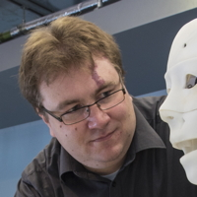
Who is Jon?
Deep learning expert at the University of Southampton
7 PhD students doing deep learning + 3rd year projects and MSc
http://users.ecs.soton.ac.uk/jsh2/
He created the first and base line for second tutorial for today
He arranged DLI Teaching Kit AWS Access ($125 per student credit )

Slide 4
Why this workshop?
Sharing experiences
Getting those who are interested in the same room
Help beginners to get started
Feedback on my approach
Sharing code
My PhD research up to 9 months
No need to reinventing the wheel
Notes:
I thought there might be some interest in this based on my presentation last year. 6 out of 9 papers are Deep Learning

Slide 5
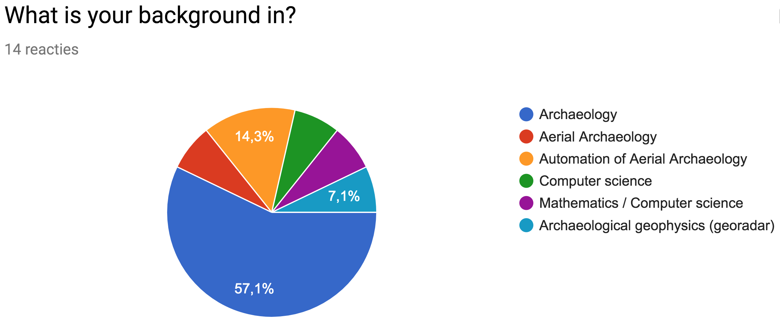
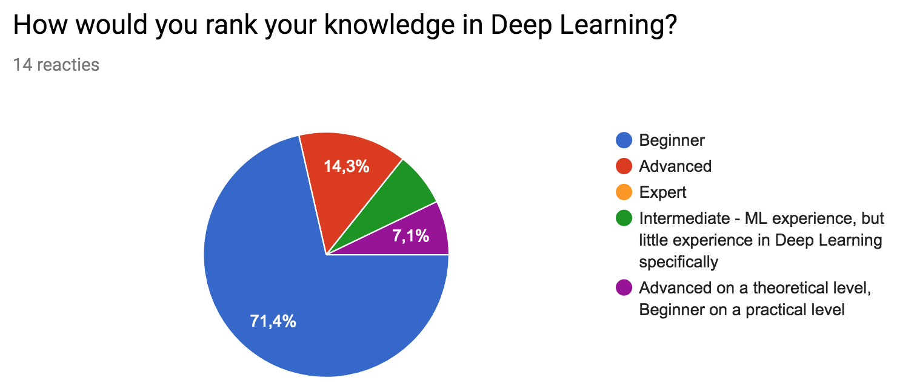
Who sits next to you?
Learning outcome?
“Basic understanding of the concept”
“An overview of the possibilities, potential, applications and understanding routes to learn/deploy more”
“Ideas for enhancing the accuracy of my current Neural Network”
“An idea of how to implement Deep Learning in archaeological software and site data analysis”
Specific topic in Deep Learning?
“Unbalanced and/or low number of training examples from each 'foreground' class, versus huge number of 'background' examples.”
“Working with small datasets.”
“application to satellite images and georeferencing issues”
“Deep learning for archaeological predictive modelling”

Slide 6
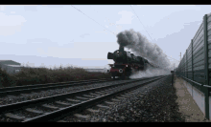
A message to 71.4% of the audience
Don’t worry, we have 4 hours and all resources are linked here:
https://github.com/ickramer/caa2018-dl-workshop

Slide 7
Schedule for the workshop
PART 1 – Introduction to everything
08:15 – 10:00
Coffee break 10:00-10:30
PART 2 – Getting more advanced
10:30 – 12:15

Slide 8
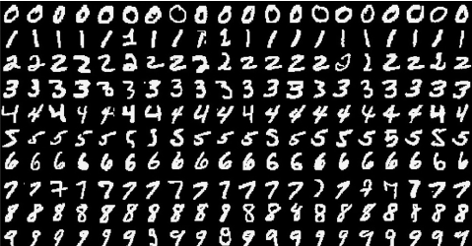
PART 1 – Introduction to everything
Intro
Remote Sensing
Automation (limited to 2015-2018)
Machine learning
Deep learning
Tutorial classifying images of MNIST dataset

Slide 9
PART 2 - Getting more advanced
Tutorial classifying barrow/not barrow
Data prep: Cropping images around objects on massive RS-images
Run a basic deep learning approach
Improve it: Beat the small data challenge
Data augmentation
Transfer learning
Using multi-modal data
Discussion on deep learning for archaeology
Types of networks
Object detection/classification/segmentation
Resources

Slide 10
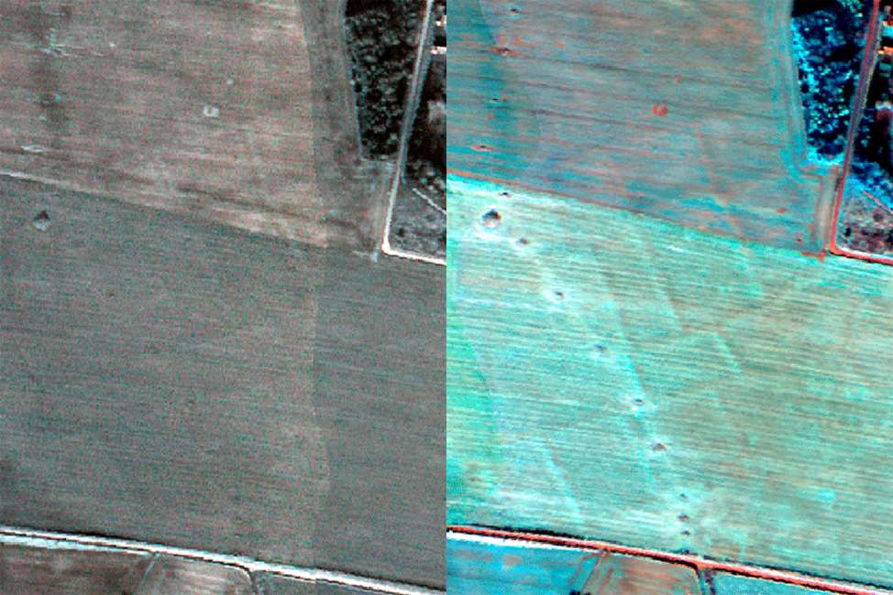
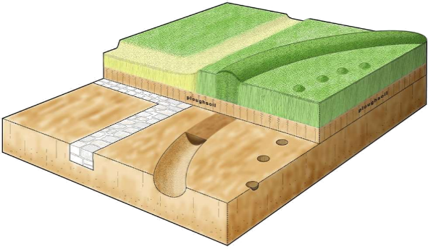
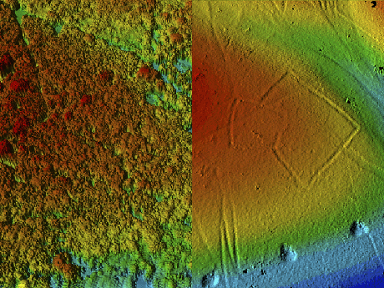
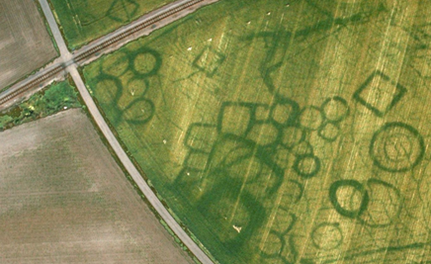
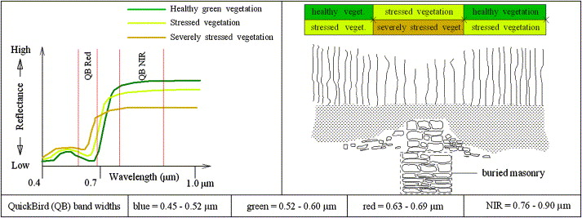
Remote Sensing
Satellite imagery
Aerial photography
LiDAR
Multi and hyper-spectral data
Top: LiDAR data processed to a DSM (top-left) and DTM (top-right). The DTM reveals slight elevation differences under this forest canopy in Savernake, Wiltshire (University of Cambridge, 2006). Bottom: The process of point data captured by a LiDAR survey (Ma et al., 2015).
Top: schematic drawing of cropmark anatomy (Historic England, 2016). Bottom: Cropmarks of various funerary monuments as seen on an aerial image in Grezac, France (Dassié, 2007).
Top: comparative multispectral imagery of prehistoric field systems near Stonehenge (Historic England). Bottom: Phenological and spectral characteristics linked to the presence of crop-marks (Lasaponara and Masini, 2012a, 26).
Notes:
LiDAR
University of Cambridge (2006) Lidar-derived images showing the effect of processing to remove the forest canopy. The image on the left is derived from the first return and shows the tops of the trees; that on the right shows the archaeology beneath the canopy. © The image is © Historic England; the lidar data is © Forestry Commission. Available from: https://content.historicengland.org.uk/remote/content.historicengland.org.uk/content/research/images/landscape-areas/south-west/lidar-dsm-dtm-savernake [Accessed 29/10/2017].
Ma, H., Song, J. and Wang, J. (2015) Forest Canopy LAI and Vertical FAVD Profile Inversion from Airborne Full-Waveform LiDAR Data Based on a Radiative Transfer Model. Remote Sensing, 7 (2), 1897.
Aerial photography
Historic England (2016) Cropmarks are differences in the colour and / or height of a crop. The variation in growth is caused by what is present below the plough-soil. The patterns of buried remains are best viewed from the air © Historic England Available from: https://historicengland.org.uk/research/current/discover-and-understand/landscapes/ [Accessed 23/02/2016].
Dassié, J. (2007) Période protohistorique. © J. Dassié. Grande nécropole gauloise avec diverses structures funéraires. Circulaires ou carrés, de toutes tailles, ces "monuments funéraires" abritaient des sépultures à incinération. Available from: http://archaero.com/Grezac.jpg [Accessed 29/10/2017].
Multi and hyper-spectral data:
Lasaponara, R., and Masini, N. 2012a. Image Enhancement, Feature Extraction and Geospatial Analysis in an Archaeological Perspective. In: Lasaponara, R., and Masini, N. (eds.) Satellite Remote Sensing: a New Tool for Archaeology. New York: Springer.) .
Image on Multi and hyper-spectral data from Historic England : https://historicengland.org.uk/research/methods/airborne-remote-sensing/satellite-and-ms-imagery/ :
One particularly useful factor that satellite imagery has over conventional photography is that most provide multi-spectral data., Rather than just the standard visible spectrum, Near infra-red (NIR) and several other wavelengths are recorded.
By manipulating the different wavelengths it is possible to reveal features not otherwise easily discernible.. This is particularly valuable for environmental monitoring, but also has some potential for archaeological survey.
Multi-spectral data can also be captured from airborne platforms, and the higher resolution data available from systems such as CASI is more useful for archaeological purposes than satellite sourced data.
As well as multispectral (M/S) data airborne platforms (and indeed a small range of satellites) also have the capacity to collect hyperspectral (H/S) data. A multispectral sensor may have a number of discrete bands within the spectrum from the visible to the longwave infrared.
A hyperspectral sensor, in contrast, will deal with numerous narrow bands over a continuous spectral range. This allows the sensor to produce the spectra for all pixels in a given scene and allows much more subtle and varied analysis.
Increased resolution in both M/S and H/S sensors over the past few years have again made this an area that is of interest to HE.

Slide 11
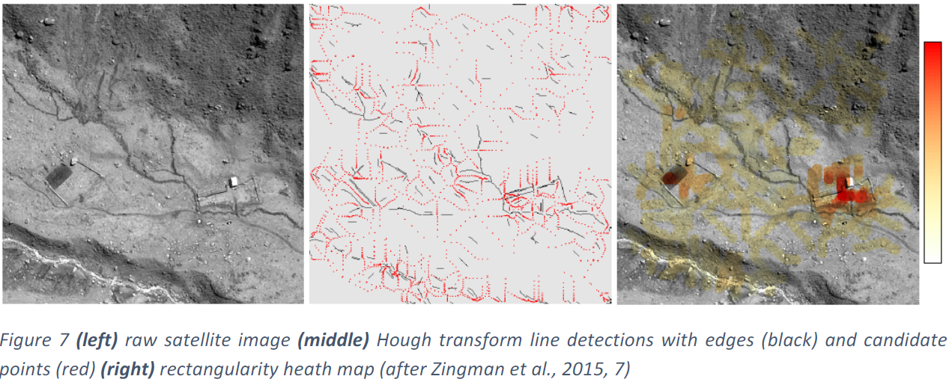
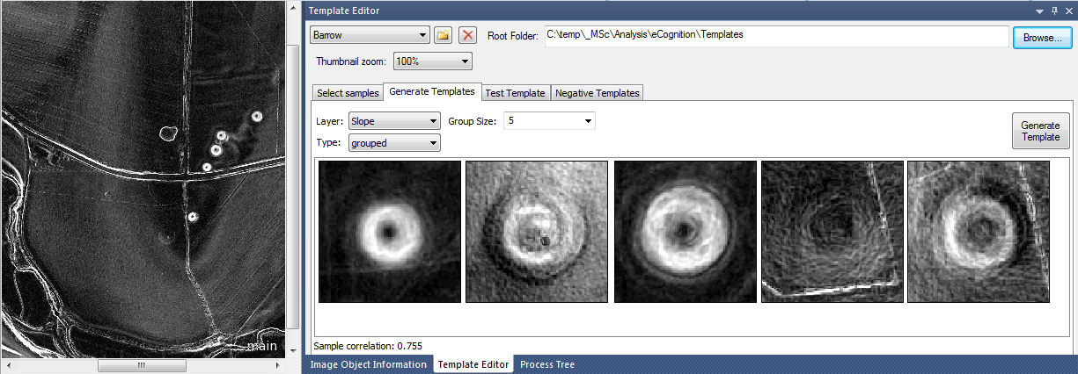
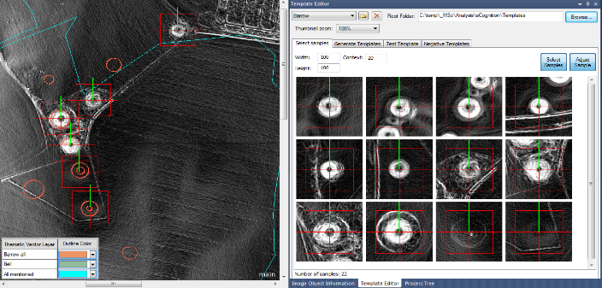
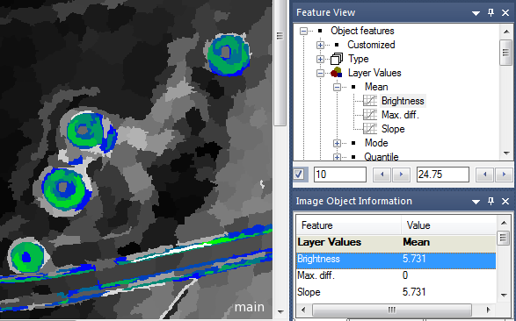
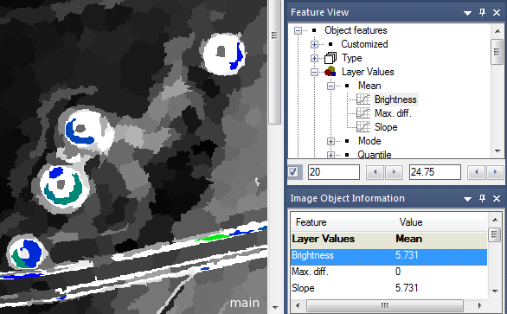
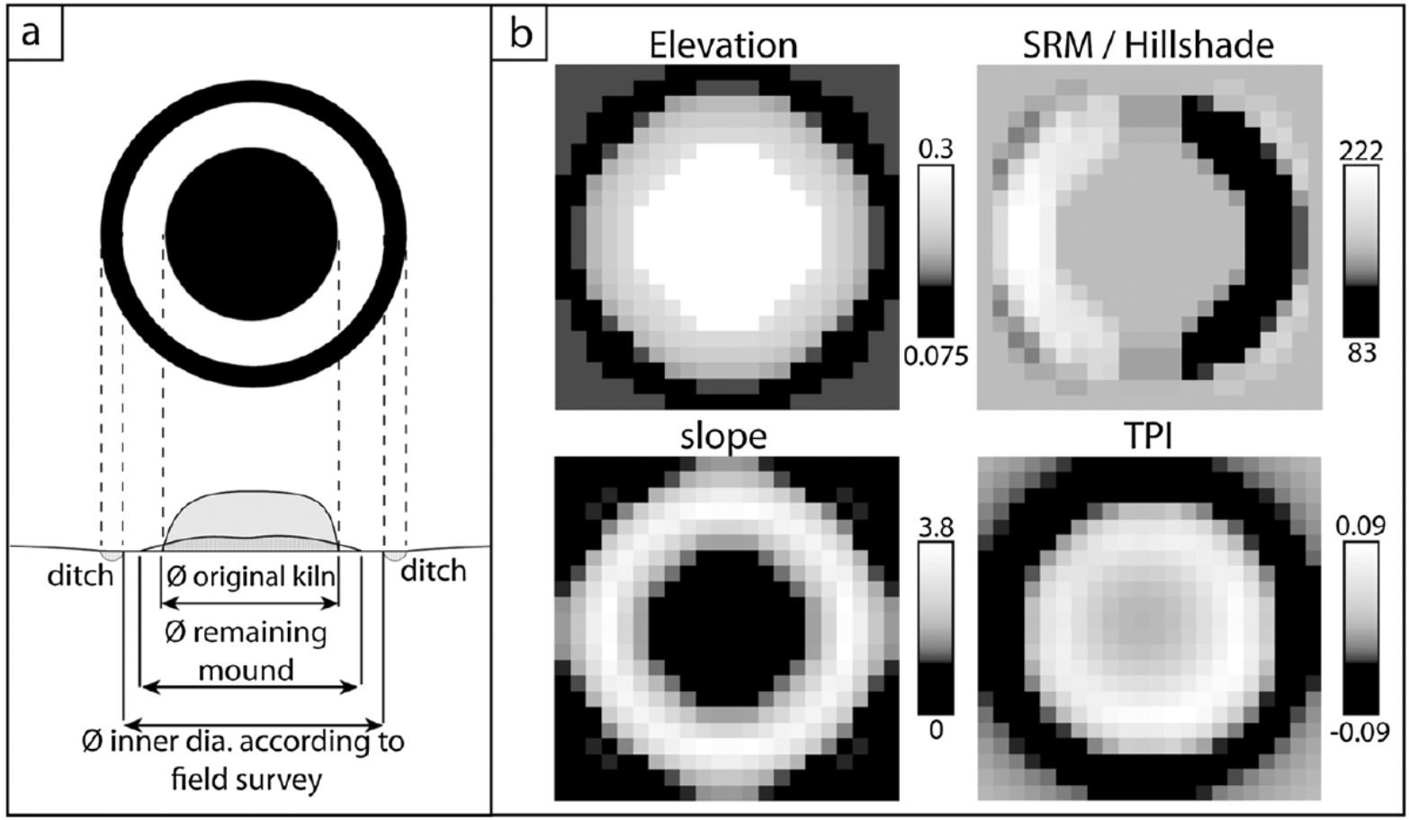
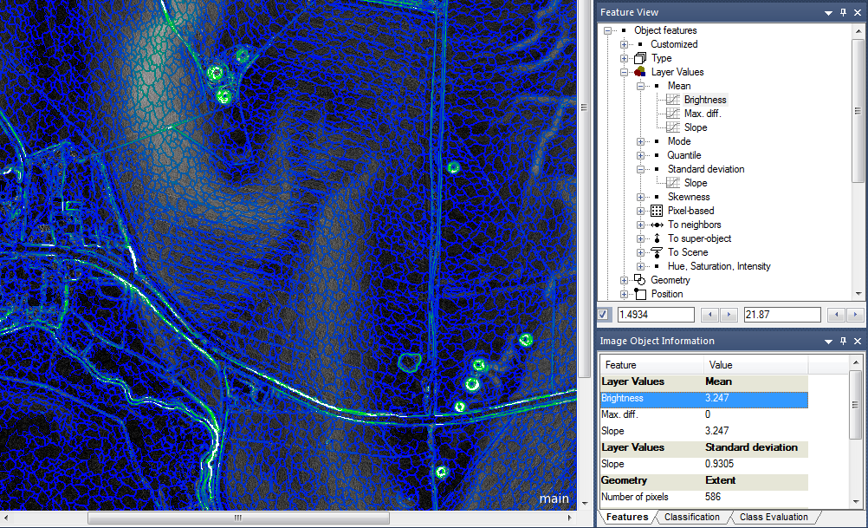
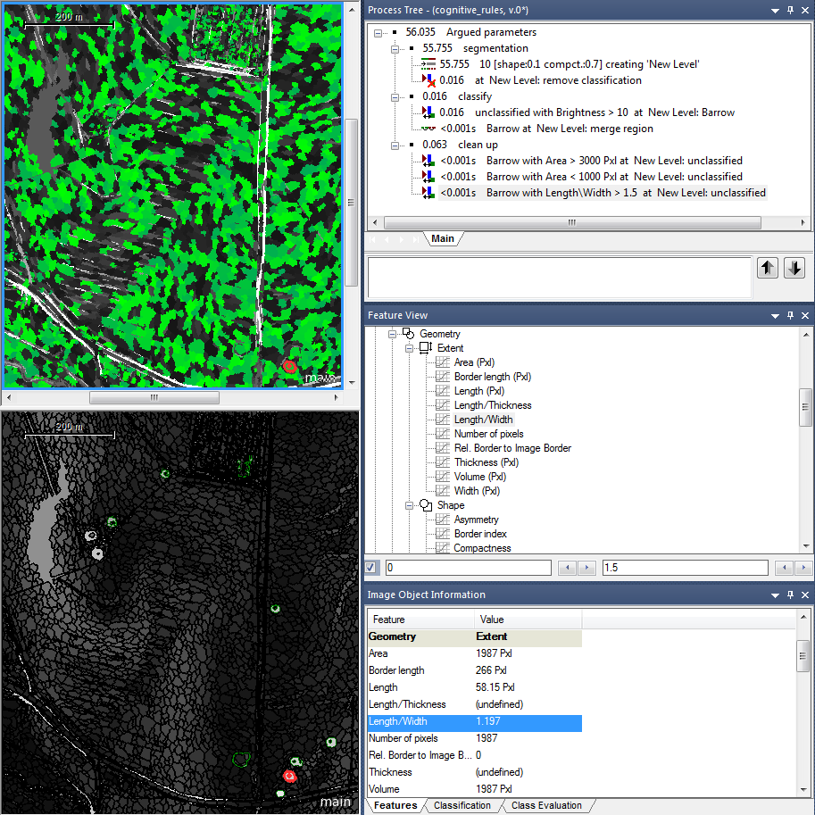
Automation anno 2015
Presented at CAA 2017 and AARG 2017
Custom algorithms
Adaptive template matching
Zingman et al. 2015
Kramer 2015
Object Based Image Analysis
Template matching with morphometric derivatives
Schneider et al. 2015
Kramer 2015
Notes:
Custom algorithm
Zingman, I., Saupe, D., and Lambers, K. 2015. Detection of incomplete rectangular contours with application in archaeology. Technical Report, University of Konstanz.
Template matching with morphometric derivatives
Schneider, A., Takla, M., Nicolay, A., Raab, A., and Raab, T. 2015. A Template-matching Approach Combining Morphometric Variables for Automated Mapping of Charcoal Kiln Sites. Archaeological Prospection, 22, 45-62.
Object Based Image Analysis and Adaptive template matching from:
Kramer, I. (2015) An archaeological reaction to the remote sensing data explosion. Reviewing the research on semi-automated pattern recognition and assessing the potential to integrate artificial intelligence, MSc, University of Southampton.

Slide 12
Critique on methods
Presented at CAA 2017 and AARG 2017
Expert system
Dependent on domain knowledge of the expert
Do not generalize well
Transferability of a model
Other objects
Other environment
Other remote sensing data
Software dependent
Expensive (e.g. ArcMap, eCognition, ERDAS imagine)
High level (e.g. MATLAB)

Slide 13

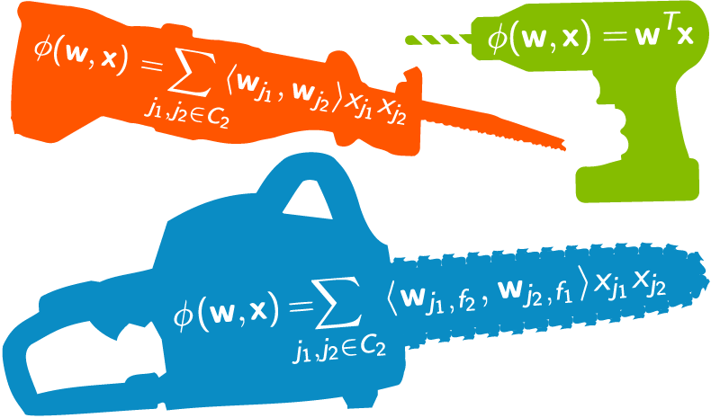
Approaches to automation
Presented at CAA 2017 and AARG 2017
Feature engineering
process of using domain knowledge of the data to create features
Custom algorithms
Template matching
Object Based Image Analysis
Feature learning
a set of techniques that learn a feature
Adaptive template matching
Machine learning
Notes:
Feature engineering image: https://www.linkedin.com/pulse/feature-engineering-data-scientists-secret-sauce-ashish-kumar/?trk=prof-post
Feature learning image: https://www.microsoft.com/net/learn/apps/machine-learning-and-ai

Slide 14
Approaches reflected on 2015 automation
Feature engineering
Feature Learning
Zingman et al. 2015
Kramer 2015
Feature engineering
Feature engineering
Schneider et al. 2015
Kramer 2015

Slide 15
After 2015: Deep learning
2016
Igor Zingman
Øivind Trier
2017
Sebastian Zambanini at CAA
New PhD students
January - Leiden University
Wouter Baernd Verschoof-van der Vaart, supervised by Karsten Lambers
May - Southampton University
Iris Kramer, supervised by Jonathon Hare & Adam Prugel-Bennett
Notes:
Zingman, I., Saupe, D., Penatti, O.A. and Lambers, K. (2016) Detection of fragmented rectangular enclosures in very high resolution remote sensing images. IEEE Transactions on Geoscience and Remote Sensing, 54 (8), 4580-4593.
Trier, Ø.D., Salberg, A.-B., Holger Pilø, L., Tonning, C., Marius Johansen, H. and Aarsten, D. (2016) Semi-automatic mapping of cultural heritage from airborne laser scanning using deep learning EGU General Assembly Conference Abstracts. 5716.

Slide 16

2018
S14: Setting the automation agenda for Remote sensing: learning to see through a computer?
Neue Aula, Room 1, 10.30 - 15.30, 20 March 2018
LiDAR-based automated detection of cultural heritage in Westphalia", M. Fabian Meyer, Ingo Pfeffer, Carsten Jürgens
Semi-automatic detection and extraction of complex burial monuments in Arabia from high-resolution multispectral satellite imagery, Giacomo Fontana Extraction of linear structures from LIDAR images using a machine learning approach, Clément Laplaige, Xavier Rodier, Jean-Yves Ramel, Bai Shuo, Ronan Guillaume
Archaeological Object Detection in Airborne Laser Scanning Data Using Convolutional Neural Networks, Bashir Kazimi, Frank Thiemann, Katharina Malek, Monika Sester
Semi-automatic mapping of cultural heritage in Arran, Scotland, using deep neural networks on airborne laser scanning data, Øivind Due Trier, David Cowley, Arnt-Børre Salberg
The use of Convolutional Neural Networks in the automated detection of archaeological objects in remotely sensed data,Wouter Baernd Verschoof-van der Vaart, Karsten Lambers
Detection of Bomb Craters in WW2 Aerial Images Using Convolutional Neural Nets, Sebastian Zambanini, Simon Brenner, Robert Sablatnig
Tackling the Small Data Problem in Deep Learning with Multi-Sensor Approaches, Iris Kramer, Jonathon Hare, Adam Prugel-Bennett
Deep learning for the benefit of archaeological remote sensing data interpretation?, Christopher Sevara, Geert Verhoeven
Teaching a computer to ‚see‘: training sets in Remote sensing archaeology, Arianna Traviglia
7 out of 9 papers are Machine Learning
6 out of 9 papers are Deep Learning
Notes:
I thought there might be some interest in this based on my presentation last year. 6 out of 9 papers are Deep Learning

Slide 17
Machine learning
Process of teaching a machine to make predictions
Supervised learning
Learn to classify or regress an item to a label or value
Labelled data, direct feedback, predict outcome/future
“Use a location of known sites to find similar sites”
Unsupervised learning
Learn groupings of items based on similarity
No labels, no feedback, “find the hidden structure”
“Let the network cluster your archive of photo’s”

Slide 18
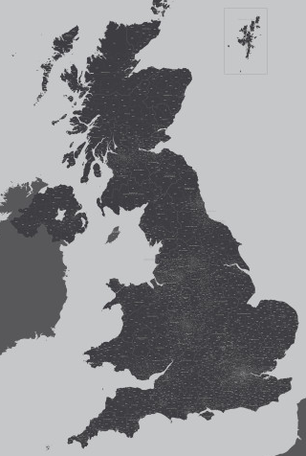
Machine learning
How does supervised learning work?
Train using know sites
Learns features
Validate on ‘unseen’ data
Limitations (before 2012)
Need a lot of labelled data
Unambiguous data

Slide 19
Deep learning
When and why became deep learning a “breakthrough” for archaeology
2012 improves ImageNet accuracy with ± 10%
± 2015 trains on small datasets
± 2015 trains on image segments
± 2017 trains on multiple remote sensing images

Slide 20
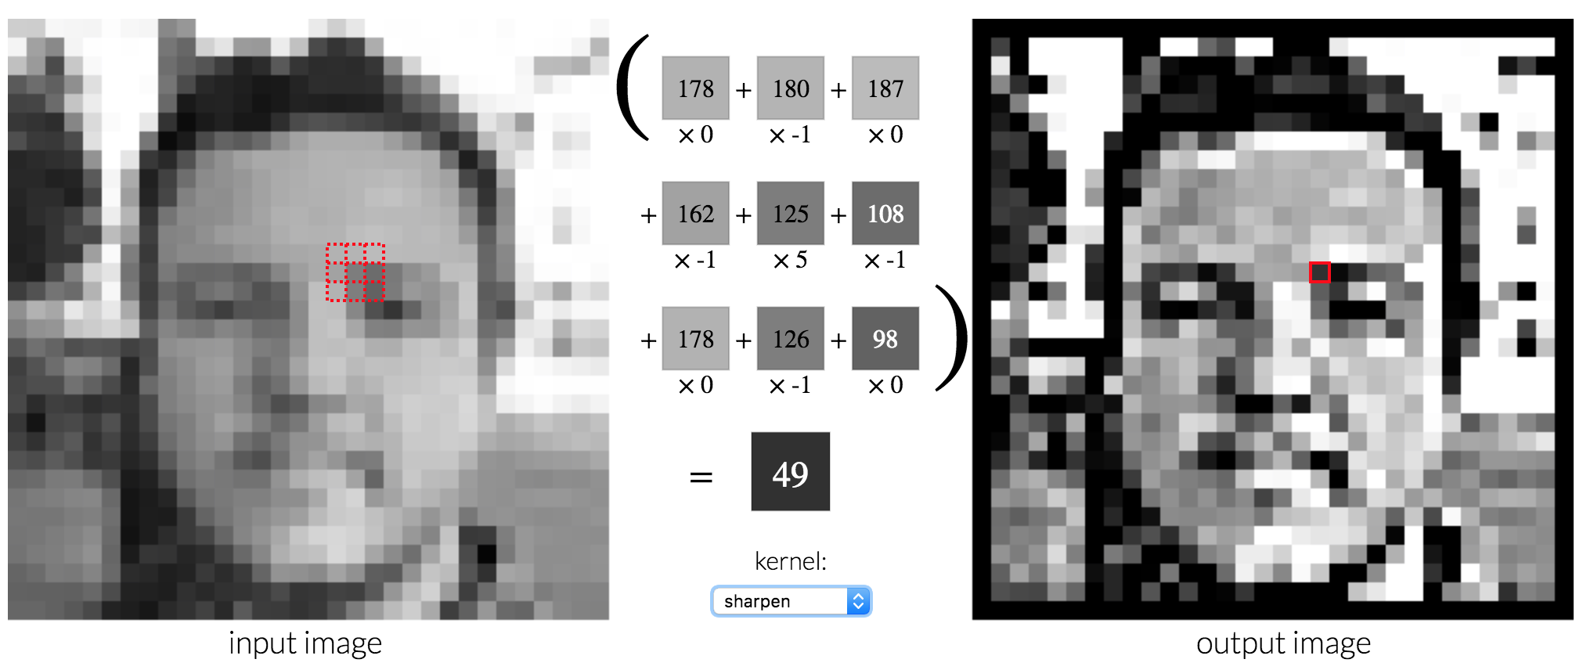
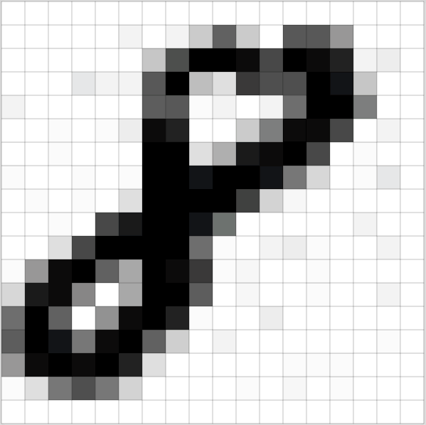
How computer vision works
Matrix multiplication
http://setosa.io/ev/image-kernels/
Notes:
Matrix multiplication is a way of combining two matrices (involving multiplying and summing their entries in a particular way)
A function takes inputs and returns outputs. For instance, f(x)=3x+5f(x)=3x+5 is an example of a function. If we input 22, the output is 3×2+5=113×2+5=11, or if we input −1−1, the output is 3×−1+5=23×−1+5=2
Functions have parameters. The above function ff is ax+bax+b, with parameters a and b set to a=3a=3 and b=5b=5.
Machine learning is often about learning the best values for those parameters. For instance, suppose we have the data points on the chart below. What values should we choose for aa and bb?

Slide 21
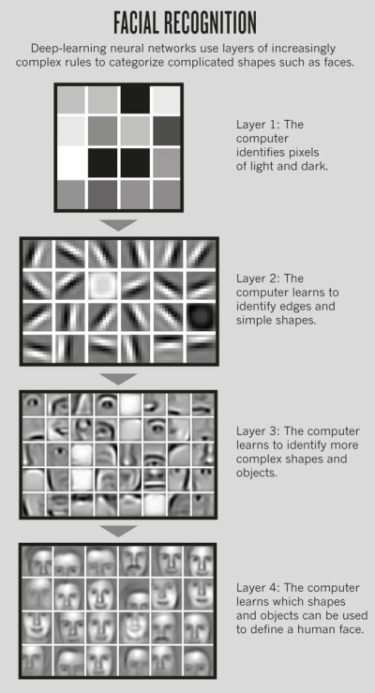
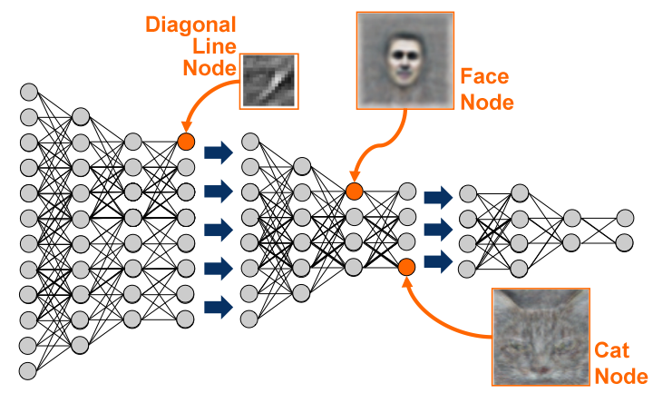
Deep learning – a network learns:

Slide 22
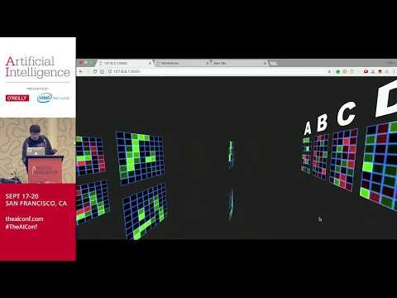
Deep Learning – typical network explained youtu.be/Oqm9vsf_hvU?t=4m23s
Notes:
Now I’ve explained what happens inside the network but let me also show you this video by the brilliant Otavio Good because he’s brilliant and made a real time demo. And people learn best by repetition and different explanations. This is going to be a nice 3D representation of a network

Slide 23
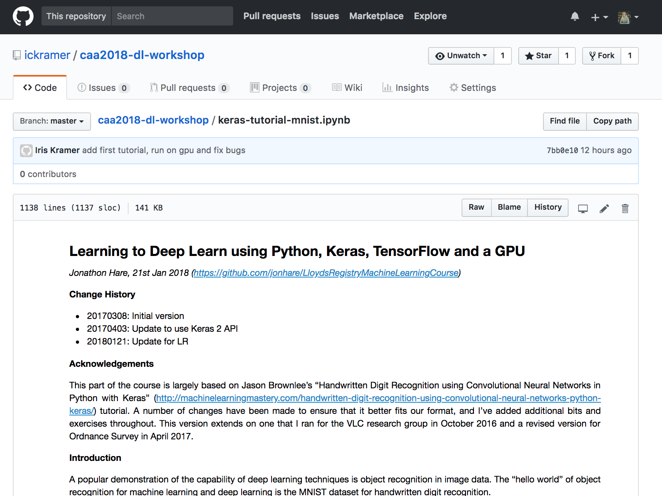
Let’s get started on the 1st tutorial
https://github.com/ickramer/caa2018-dl-workshop/blob/master/keras-tutorial-mnist.ipynb

Slide 24
PART 2 – getting more advanced
Exciting research areas
R-CNN
Mask R-CNN (instance segmentation)
U-Net (semantic segmentation)
Help your approach to get better
Multiple remote sensing datasets
Using data derivatives
Multi-modal networks
Where to find research

Slide 25
Exciting research areas
R-CNN

Slide 26
Exciting research areas
Mask R-CNN

Slide 27
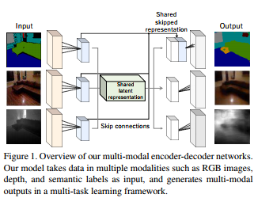
Exciting research areas
Semantic segmentation
Unet https://youtu.be/81AvQQnpG4Q

Slide 28
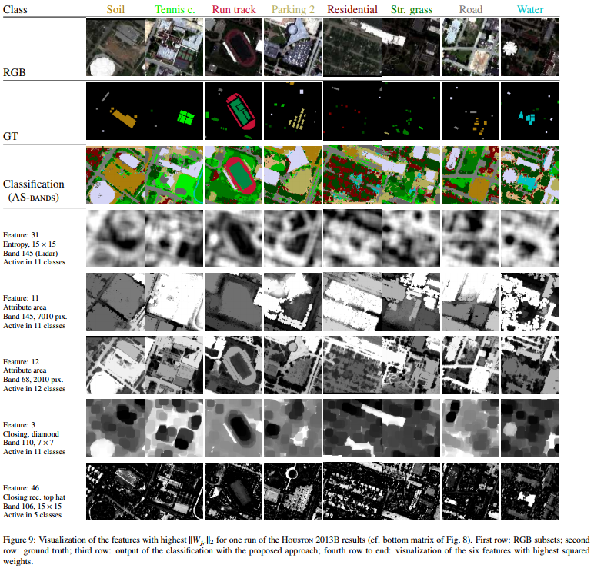
Help your approach to get better
Multiple remote sensing datasets
Using more RS-datasets in your area should realistically improve the final accuracy
Concatenating results for each RS-type of separately trained networks
Can also be improved with creation of data derivatives like NDVI
although this will decrease the automation and force your approach to find only what you see
Stacking layers
not always successful with small dataset
Multi-modal network for advanced connections between bands
different bands can learn from each other so a network that leverages this would be ideal

Slide 29
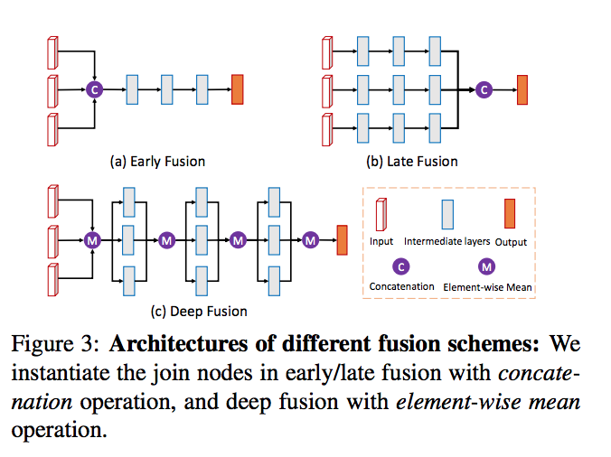
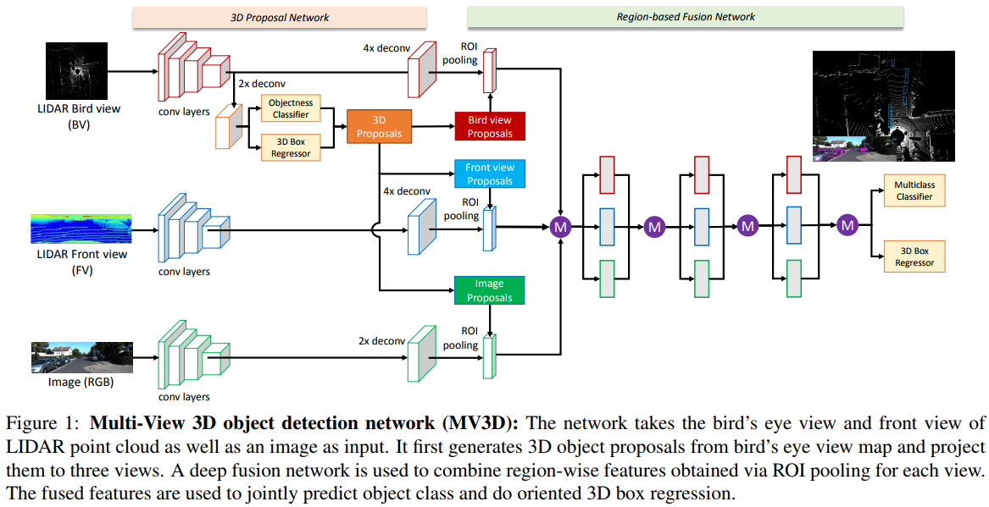
Multi-modal networks

Slide 30
Looking for relevant research when there aren’t many archaeological examples?
Kaggle competitions
https://www.kaggle.com/c/dstl-satellite-imagery-feature-detection
Dstl Satellite Imagery Feature Detection
Can you train an eye in the sky?
https://www.kaggle.com/c/planet-understanding-the-amazon-from-space
Planet: Understanding the Amazon from Space
Use satellite data to track the human footprint in the Amazon rainforest
Fast moving field
Need for arxiv.org - Open access e-prints
http://www.arxiv-sanity.com/
Notes:
Replicating kaggle competitions for archaeological datasets. Super useful kernels that they open source like https://www.kaggle.com/philschmidt/multilabel-classification-rainforest-eda. Search archaeology vs satellite imagery cnn segmentation

Slide 31
Useful online courses
Fast.ai
Andrew NG’s deep learning course on Coursera

Slide 32
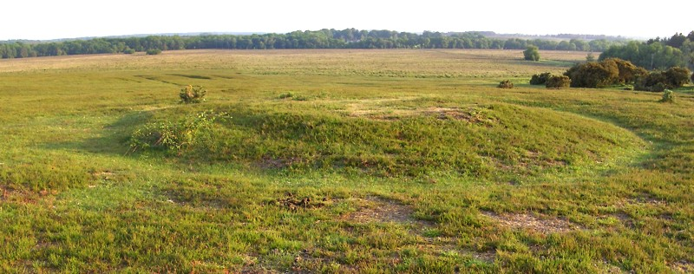
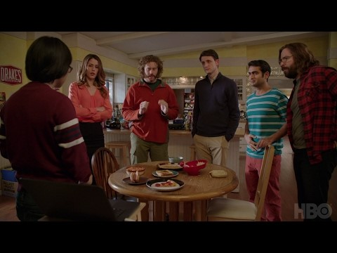
PART 2 – Barrow detection in New Forest
Barrow / not barrow
Hotdog / Not Hotdog - Silicon Valley (HBO)
Picture of a barrow captured by Champion (2006), at Longdown (New Forest, grid ref SU36280830). This barrow is 8 metres in diameter and up to 0.5 metres high
https://youtu.be/ACmydtFDTGs

Slide 33
Part 2 – Barrow detection in New Forest
Barrow / not barrow
Focus on
Small data problem – overfitting
Cropping data – GDAL
Explore the data – train/valid/test split
Figure 3 Picture of a barrow captured by Champion (2006), at Longdown (New Forest, grid ref SU36280830). This barrow is 8 metres in diameter and up to 0.5 metres high

Slide 34
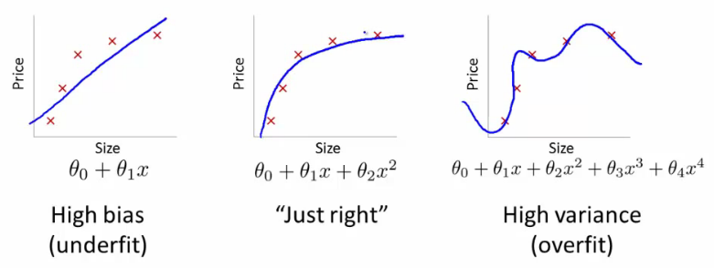
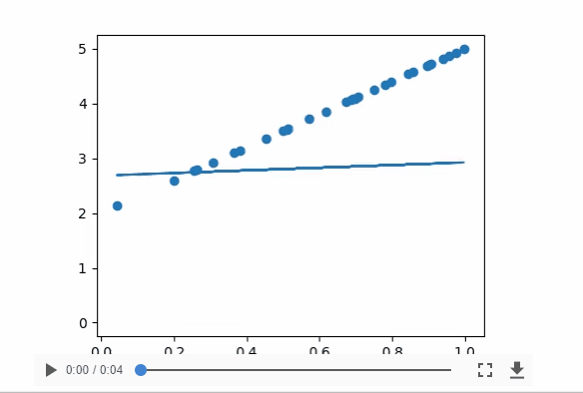
Small data problem - overfitting
The model learns patterns that do not generalize to new data
The model starts using irrelevant features for making predictions

Slide 35
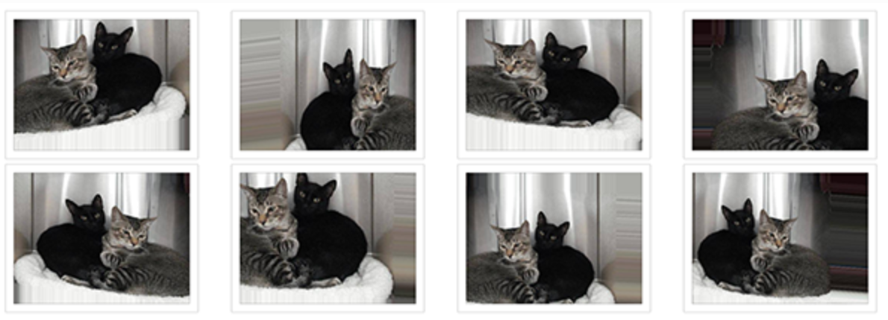
Overcoming overfitting
Increase data size
Data augmentation
Improve network
Dropout
L2 regularization
Using pre-trained network
Freeze weights (only train last few layers)
Train whole network but keep initial weights

Slide 36
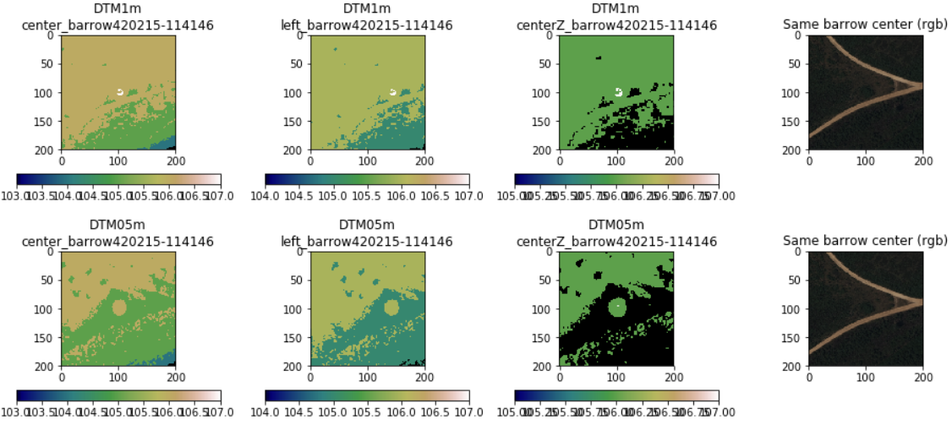
Cropping barrows from big images
New Forest case study
260-431 barrows
Cropped to 100 x 100 meter images
Using Gdal
RGB (+NIR) DTM-1m DTM0.5m

Slide 37
When coding with geographical data - GDAL
Used in the backend for ArcMap and Q-GIS
I use it for
Modifying raw remote sensing data
cropping objects from massive images
Using VRT files for massive images
Delaying a computation until the result is required
http://www.perrygeo.com/lazy-raster-processing-with-gdal-vrts.html
Useful for you?
GD specific topic: “application to satellite images and georeferencing issues”
Learn from -https://medium.com/planet-stories/a-gentle-introduction-to-gdal-part-1-a3253eb96082
Notes:
VRT file format http://www.perrygeo.com/lazy-raster-processing-with-gdal-vrts.html
What it does: delaying a computation until the result is required
Use for the binary classification: not creating any images from the big tif but only writing coordinate files of positive/negative examples and loading the information in deep learning network as minibatches, so only when computation is needed
Use for big tif segmentation task: similar approach with computing in minibatch rather than loading the image in memory
Why? Speed up and useful for sparse data problems within big data, like mine…

Slide 38
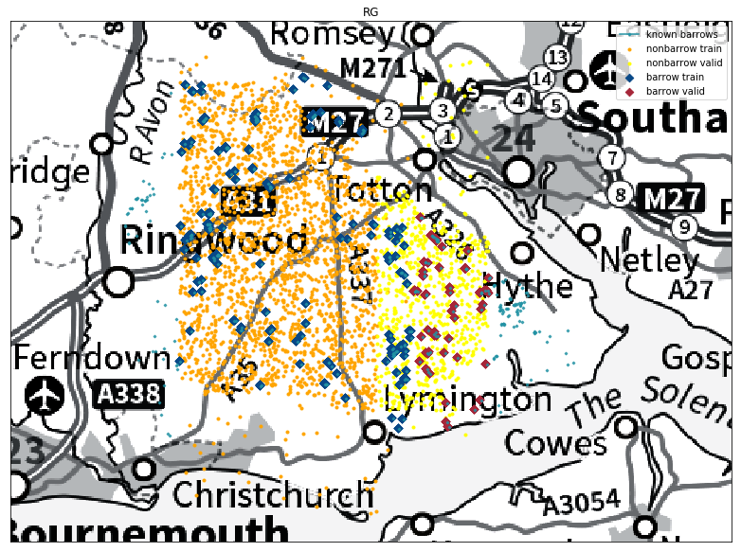
60% training, 30% validation data, 10%
174 training examples
87 validation examples
(31 test images)

Slide 39
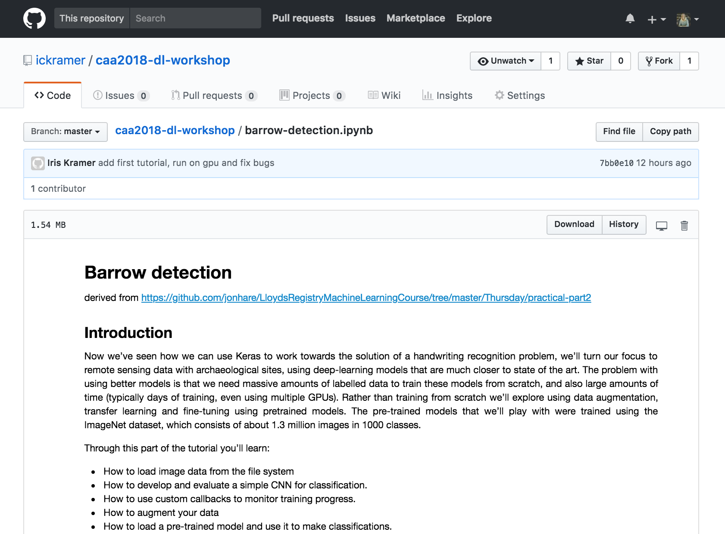
Let’s get started on the 2nd tutorial
https://github.com/ickramer/caa2018-dl-workshop/blob/master/barrow-detection.ipynb

Slide 40
Did we learn something?
Learning outcome?
“Basic understanding of the concept”
“An overview of the possibilities, potential, applications and understanding routes to learn/deploy more”
“Ideas for enhancing the accuracy of my current Neural Network”
“An idea of how to implement Deep Learning in archaeological software and site data analysis”
Specific topic in Deep Learning?
“Unbalanced and/or low number of training examples from each 'foreground' class, versus huge number of 'background' examples.”
“Working with small datasets.”
“application to satellite images and georeferencing issues”
“Deep learning for archaeological predictive modelling”

Slide 41
Building our army of machine learners
Have a forum?
Have a slack channel?
Facebook group
I’m working on a blog
Sharing code
Linking to your researches
Let’s discuss this further at the session tomorrow “Setting the automation agenda for Remote sensing: learning to see through a computer?”

